Slide 1


HOTEL BOOKING DEMAND
July 2022
Aarib Mohammed
Harshit Jain
Juhi Patel
Kshitij Mahajan
A dive into understanding features driving the risk of heart disease by developing machine learning models
A deep dive into understanding factors that affect hotel booking by developing machine learning models

Slide 2
Today we’ll discuss…
Problem Statement
Dataset Description
Exploratory Data Analysis
Various Models
Selected Predictive Model
Conclusion

Slide 3

What are we trying to solve for…
How predictors play a role in behaviors that cause booking cancellations
Building a machine learning model that predicts the cancellation chances of a hotel booking

Slide 4

Dataset Description
~ 79.3k observations for City Hotel
~ 40k observations for Resort Hotel
31 variables
Lead Time
Cancellation
Average daily rate
Cleaning of data:
Filling null rows with zero
Removed columns that were not related
Label encoding was done to convert all categorical variables into numerical variables
Removing data that showed no one as booking the hotel

Slide 5

Dataset Description
Preprocessing of data:
The data had around 75000 not canceled booking compared to 40000 canceled booking
To balance the dataset, Synthetic Minority Over-sampling Technique (SMOTE) technique of over sampling was applied to avoid overfitting
Variance inflation factor technique was used to remove the multi-collinear features and led to removal of the following columns: Arrival_date_year, reserved_room_type, distribution_channel, reservation_status_date, and reservation_status
This reduced the features from 31 to 22 using VIF

Slide 6
Variables
Cancelled: Whether customer cancelled or not Lead Time : How many days prior to arrival the booking was made Repeated Guest: If the booking was from a repeated guest Arrival date Month: Month of arrival date Arrival date Week: Week of arrival date Arrival date Day: Day of arrival date Stay in Weekends: Number of weekend nights the guest stayed or booked to stay at the hotel Stay in Weeknights: Number of Weeknights the guest stayed or booked to stay at the hotel Adults: Number of Adults Children : Number of Children Babies: Number of Babies Previous Cancellations: Number of previous bookings cancelled by guest Required Car Spaces: Number of car spaces needed | Distribution Channel: Booking channel: Travel agent or tour operator ADR: Average Daily Rate Agent: Agent ID Assigned room type: Code for type of room Booking changes: Number of changes made to the booking since booking was received Country: Country of origin Customer Type: Either Contract, group, Transient or Transient-party Day in waiting list: Number of days spent in the waiting list Deposit Type: Type of deposit made in the beginning: No deposit, non-refundable, or refundable Market Segment: Travel agents or Tour operators Meal : Type of meal booked Previous Booking Not Cancelled: Number of previous bookings not cancelled by guest Special Requests: Number of special requests
Notes:
Aarib

Slide 7
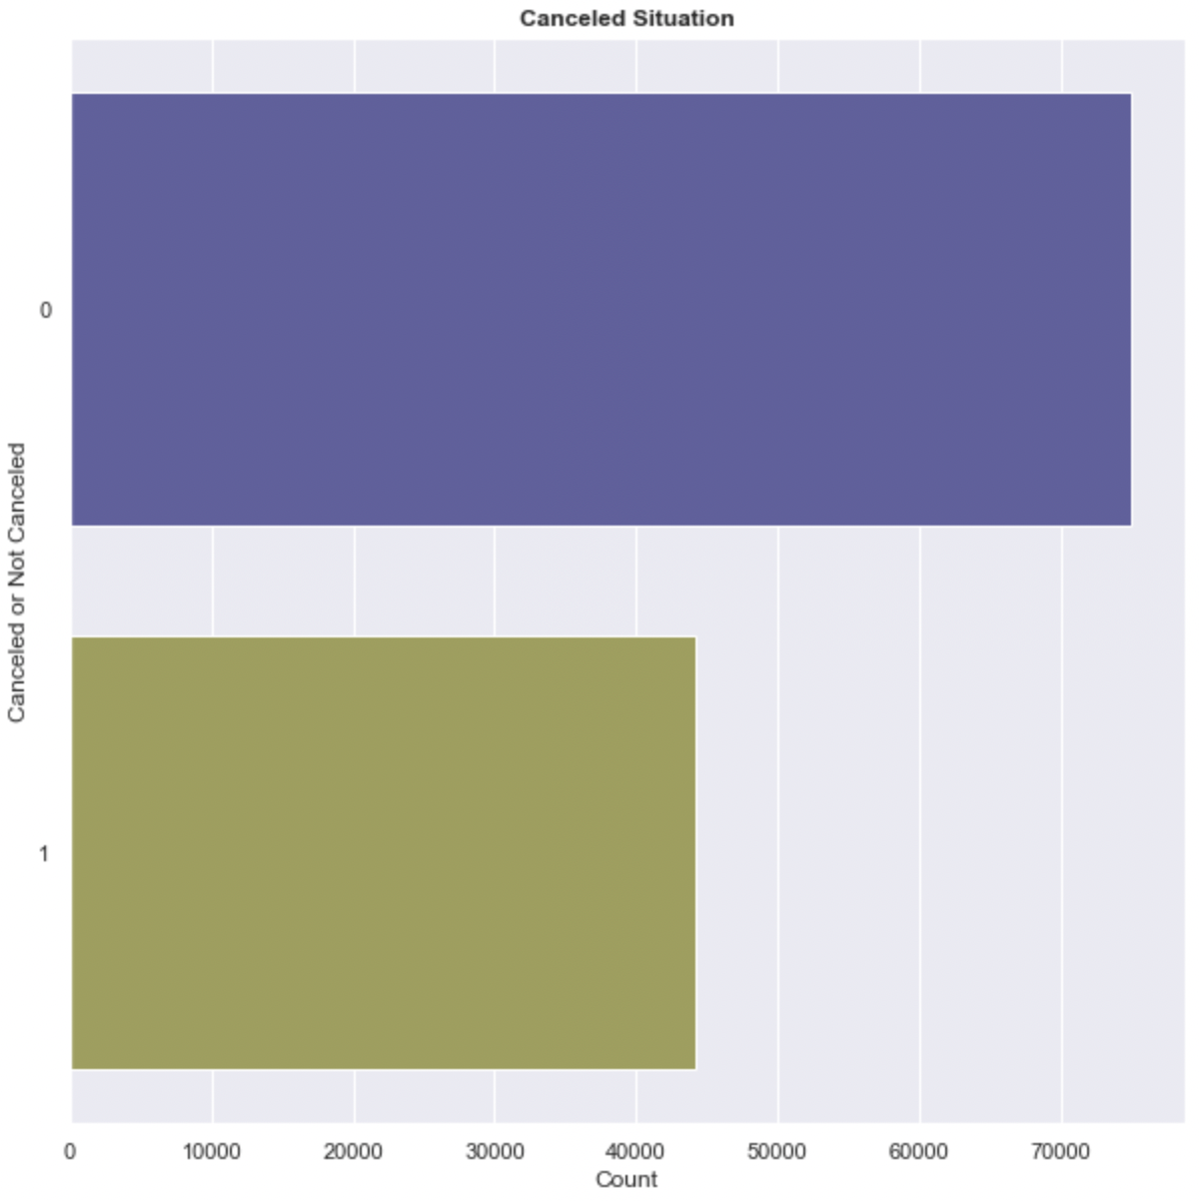
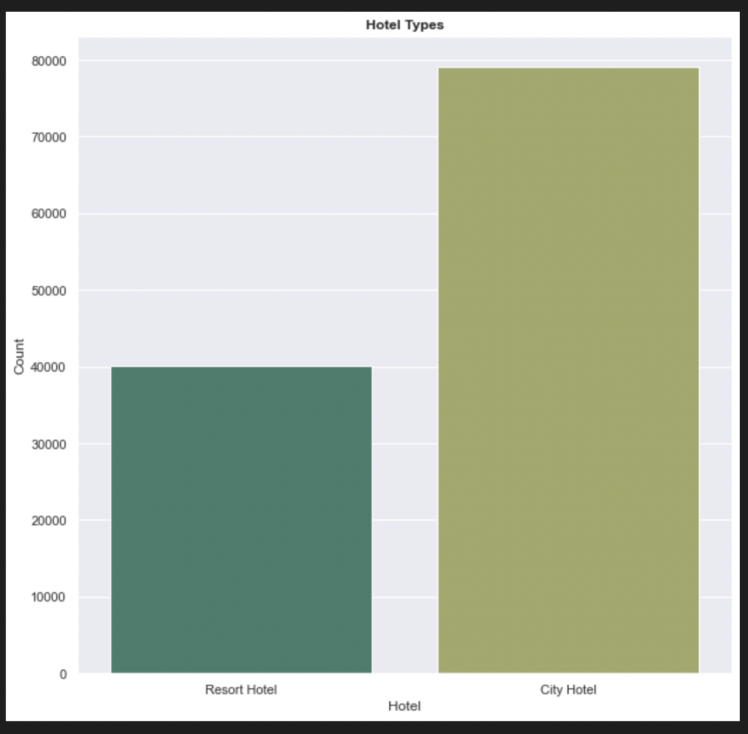
Exploratory Data Analysis

Slide 8
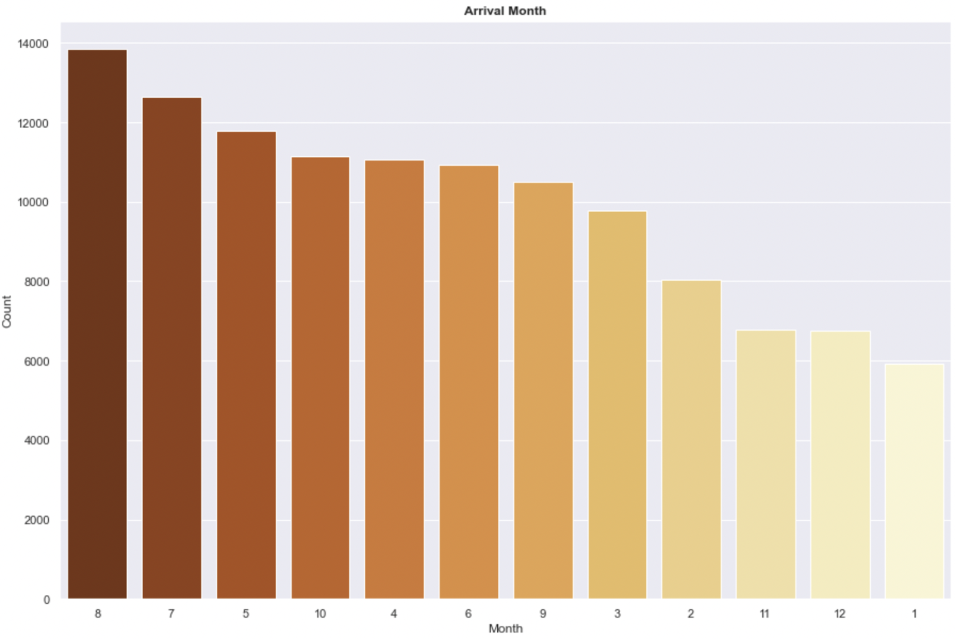
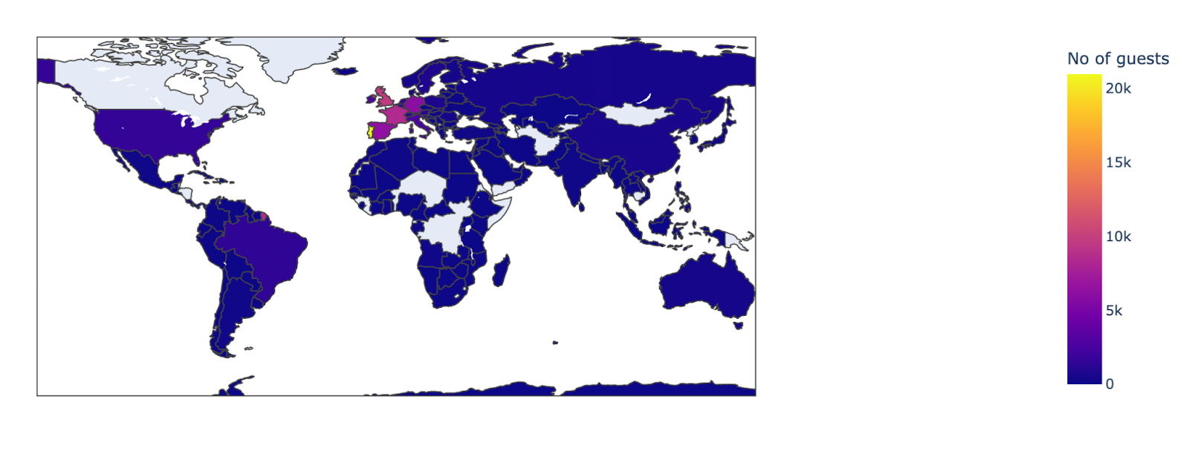
Exploratory Data Analysis

Slide 9
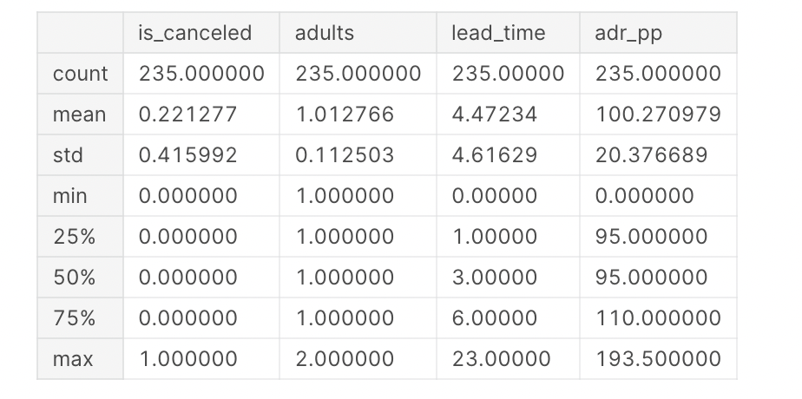
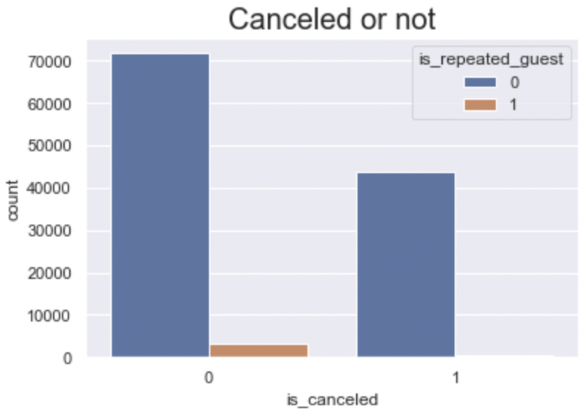
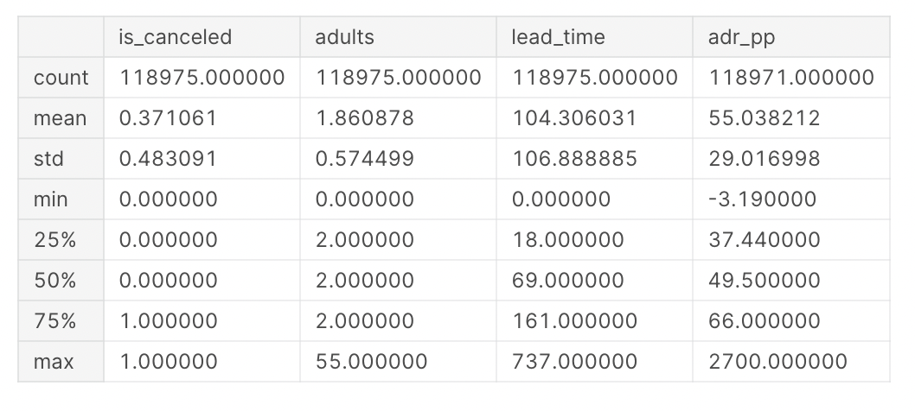
Exploratory Data Analysis
Airlines Booking Data
Booking Data except Airlines

Slide 10
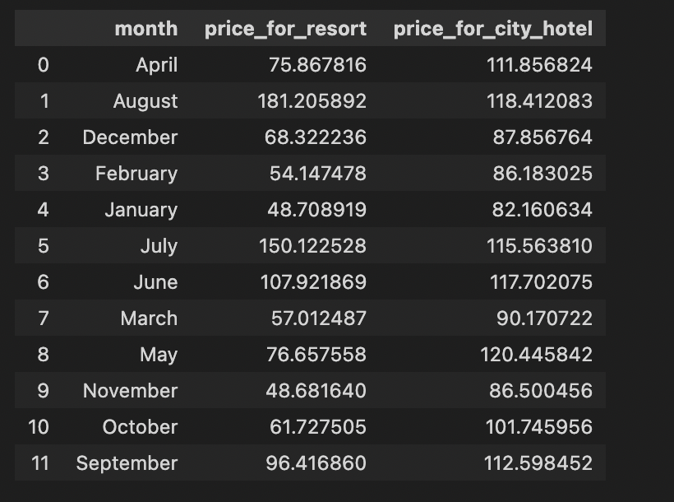
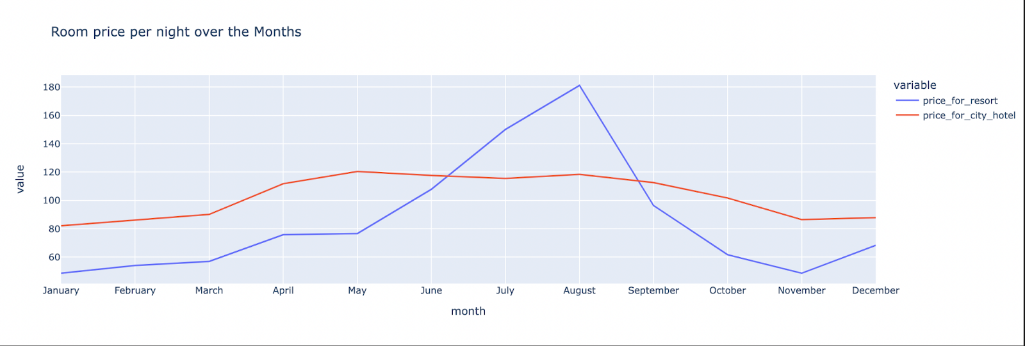
Exploratory Data Analysis

Slide 11
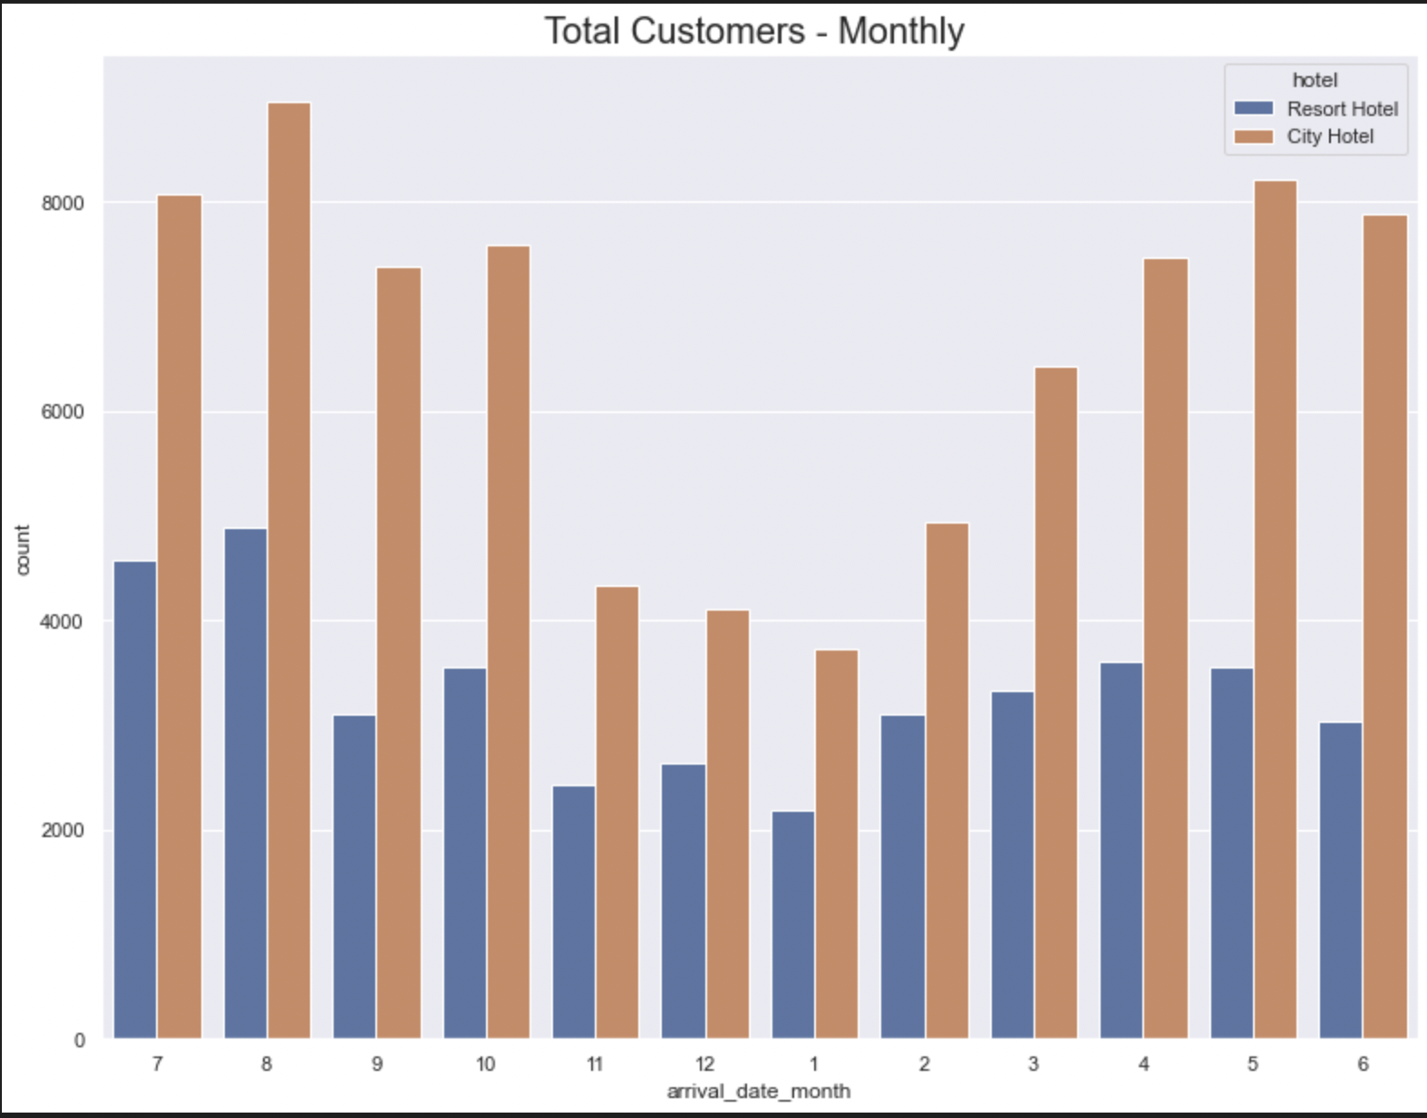
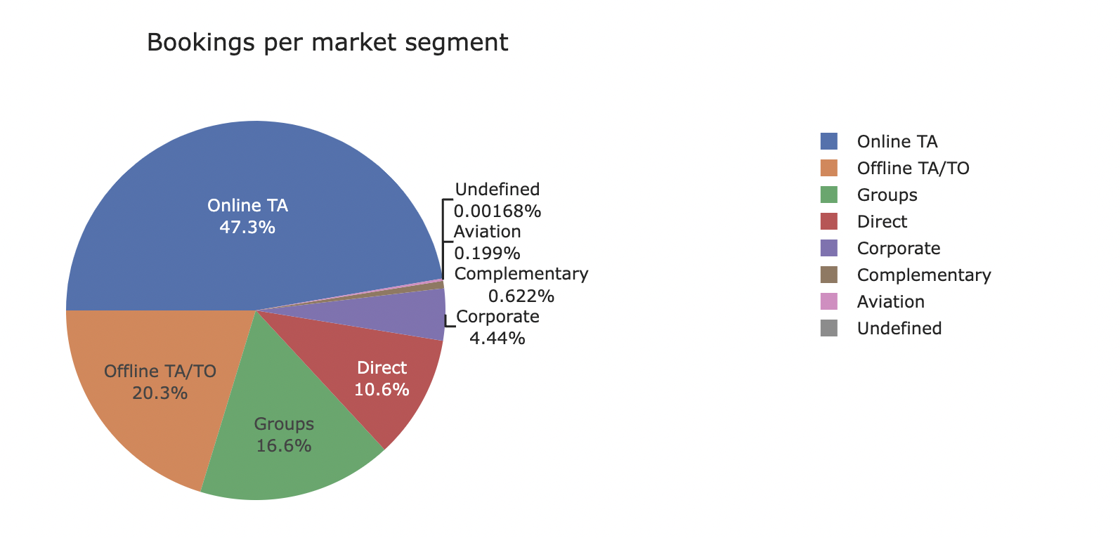
Exploratory Data Analysis

Slide 12
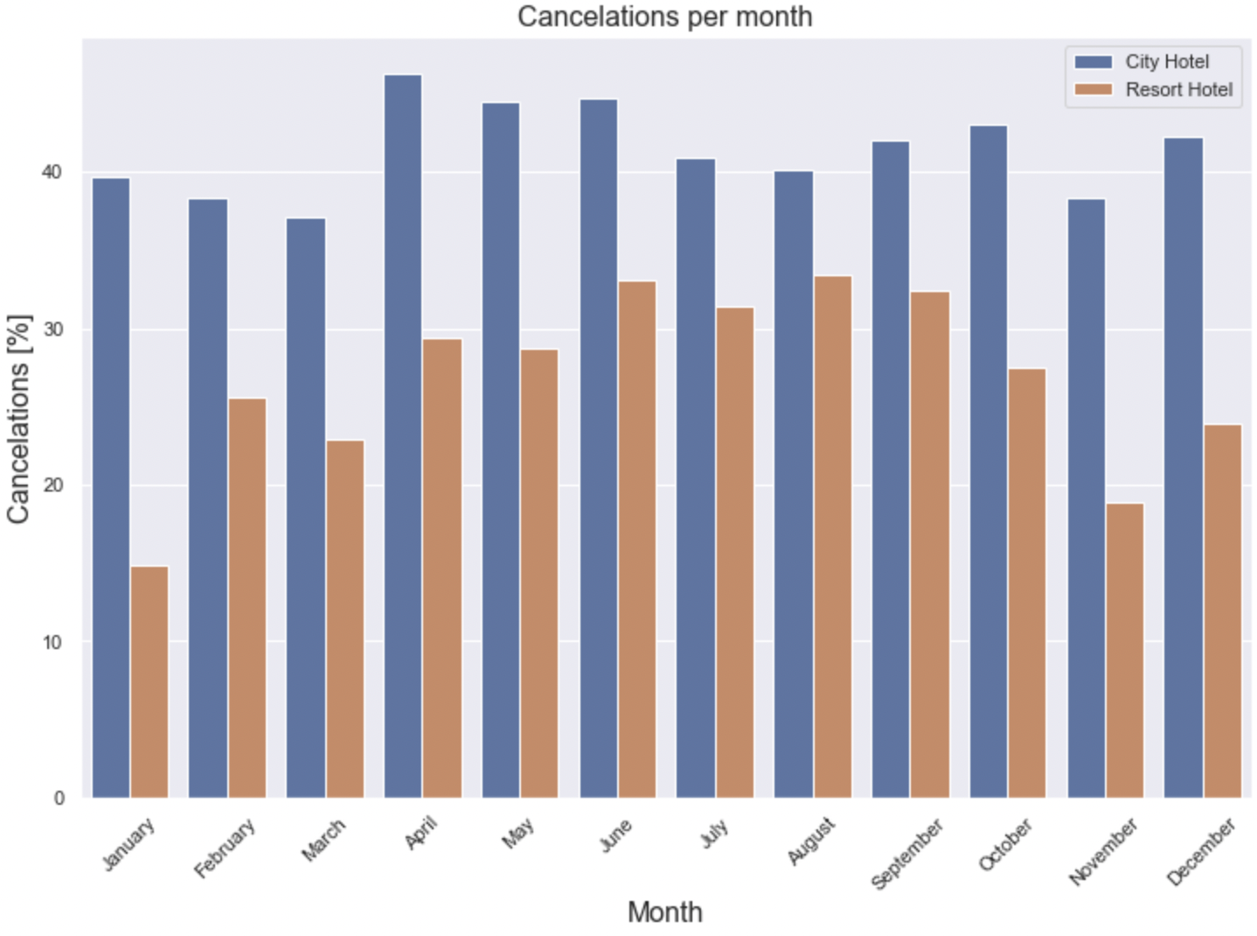
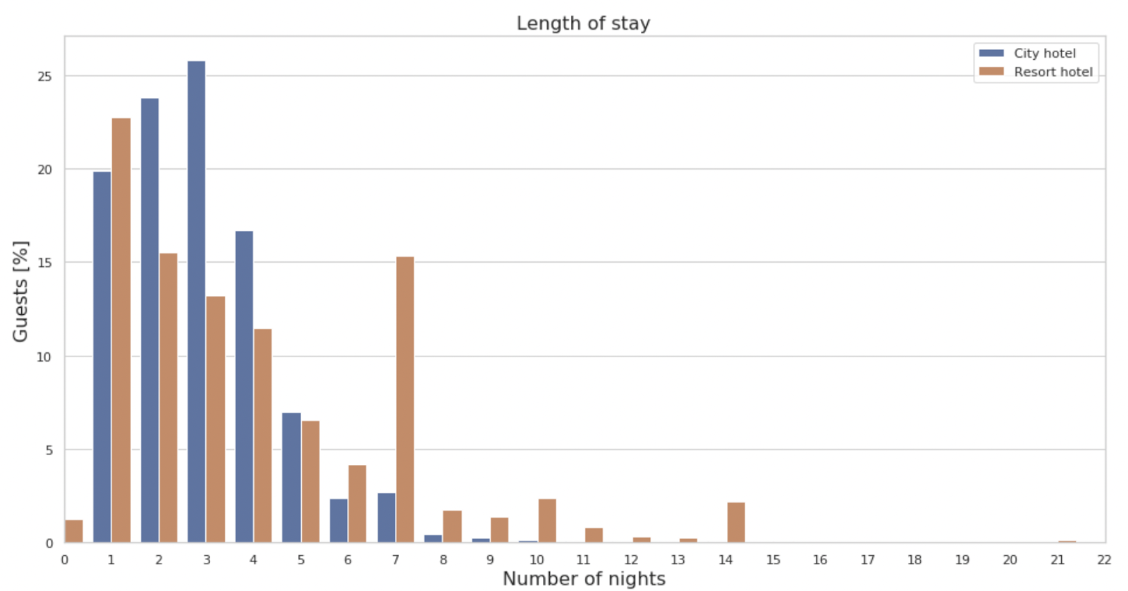
Exploratory Data Analysis

Slide 13




Exploratory Data Analysis Summary
When looking at repeated guests, we found that the repeated guests cancellation is nearly negligible. All the cancellations are done by first time visitors
44,000 canceled reservations and 75,000 not canceled bookings in the dataset
City hotel bookings were cancelled at a much higher rate 42% versus resorts at modest 28%
On average, groups get the best prices and Airlines pay approximately twice as much. The high prices paid by airlines might be due to lead time for bookings from aviation being very short: mean 4 days vs. 104 days for other bookings
Winter season had the lowest prices per night whereas the months of July and August are extremely expensive for both type of hotels
Notes:
Harshit

Slide 14
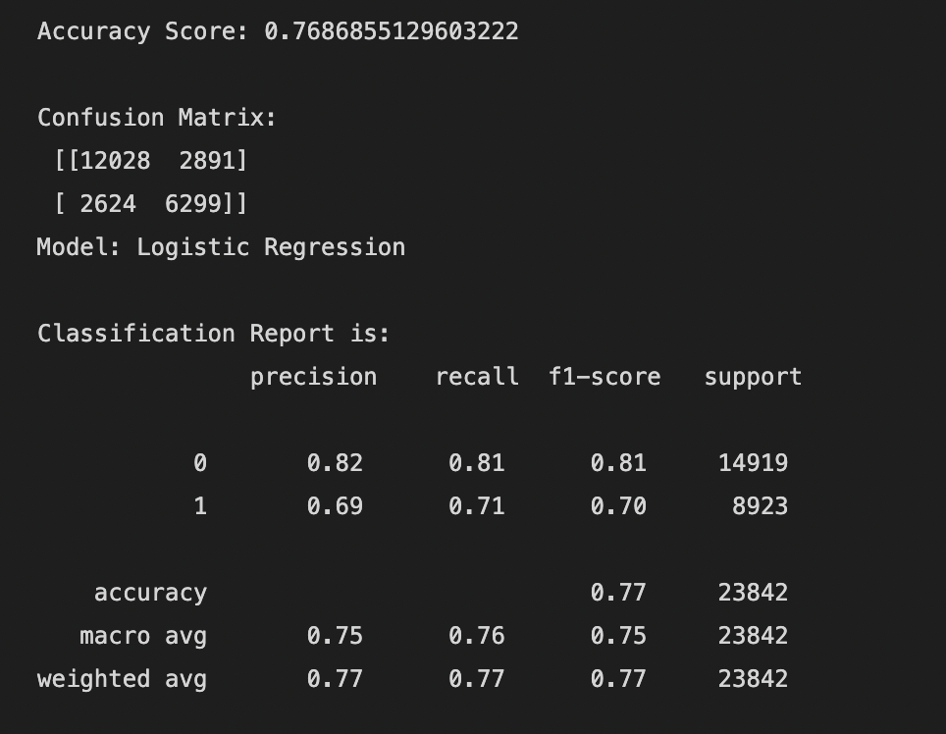
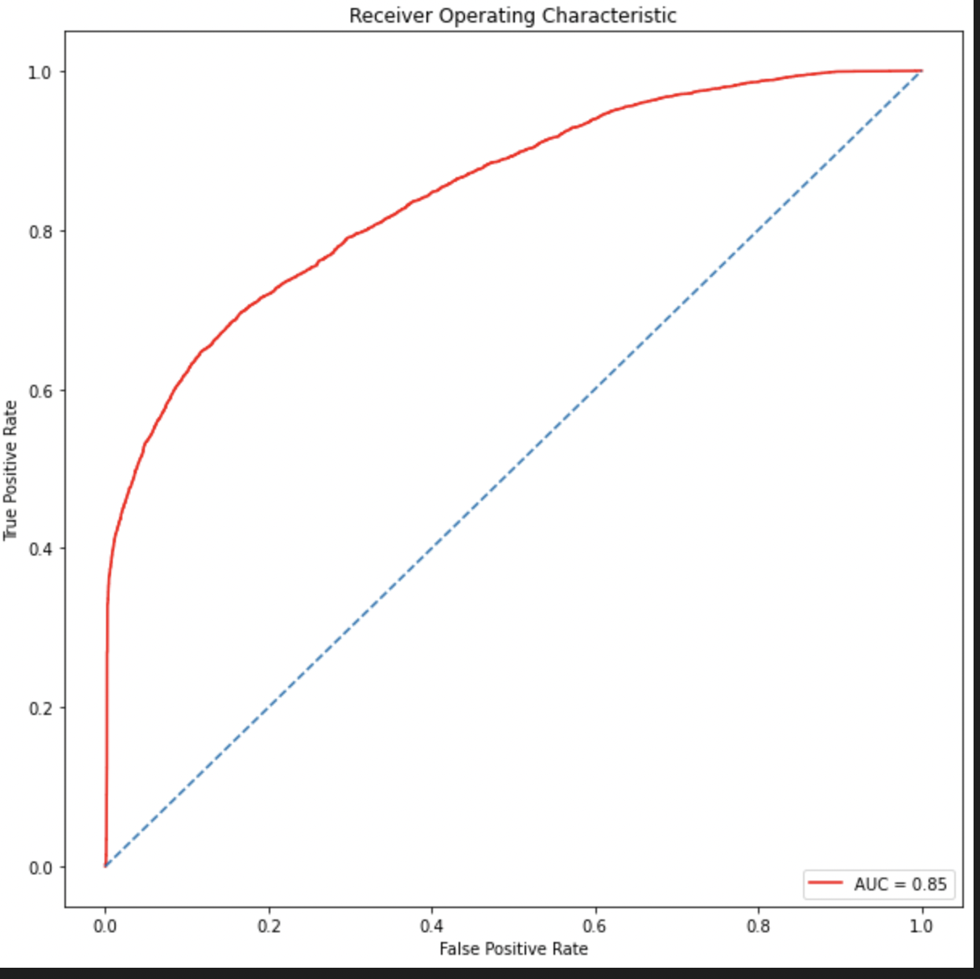
Logistic Regression Model
Logistic regression is a statistical model that in its basic form uses a logistic function to model a binary dependent variable, although many more complex extensions exist
Achieved an accuracy of 77 percent with the area under ROC curve of 0.85
Test train split = 20%;

Slide 15
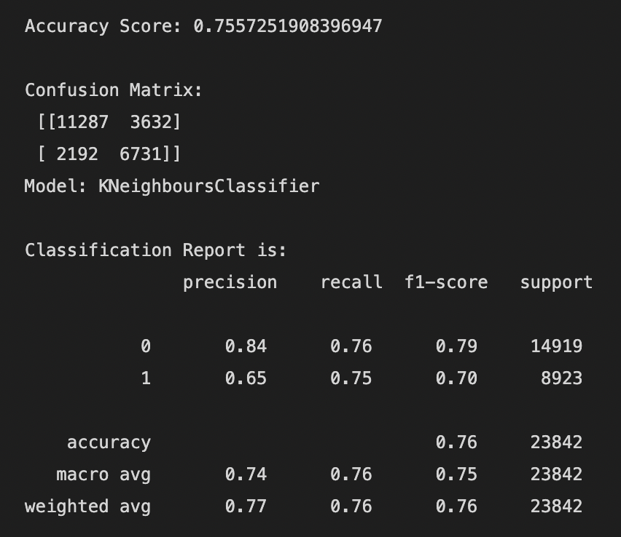
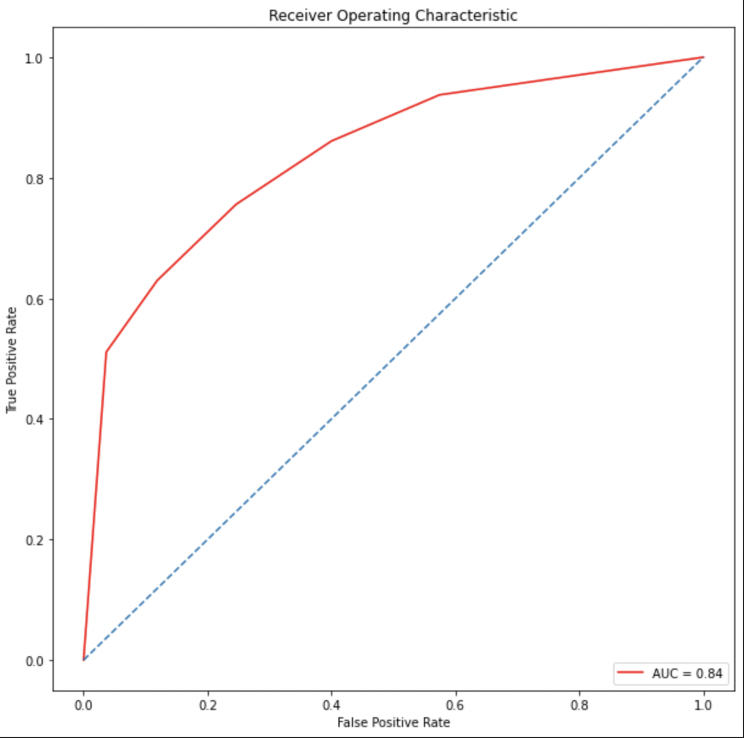
K Nearest Neighbors
By default, the K Neighbors Classifier looks for the 5 nearest neighbors
We must explicitly tell the classifier to use Euclidean distance for determining the proximity between neighboring points
KNN achieved accuracy score of 75% with the area under ROC curve of 0.84
Test train split = 20%

Slide 16
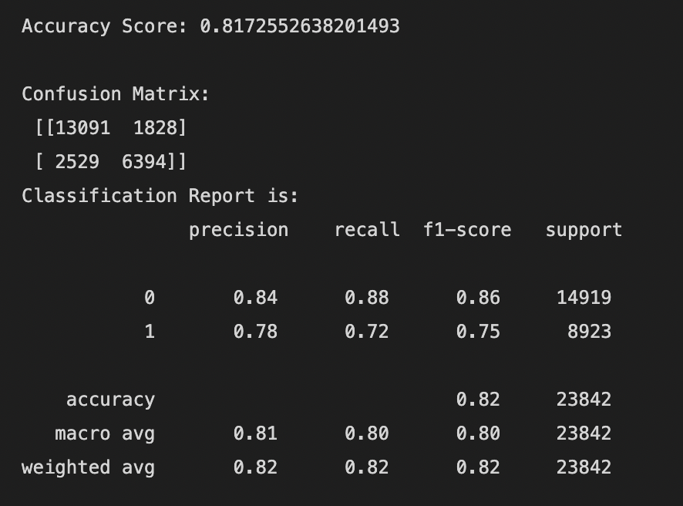
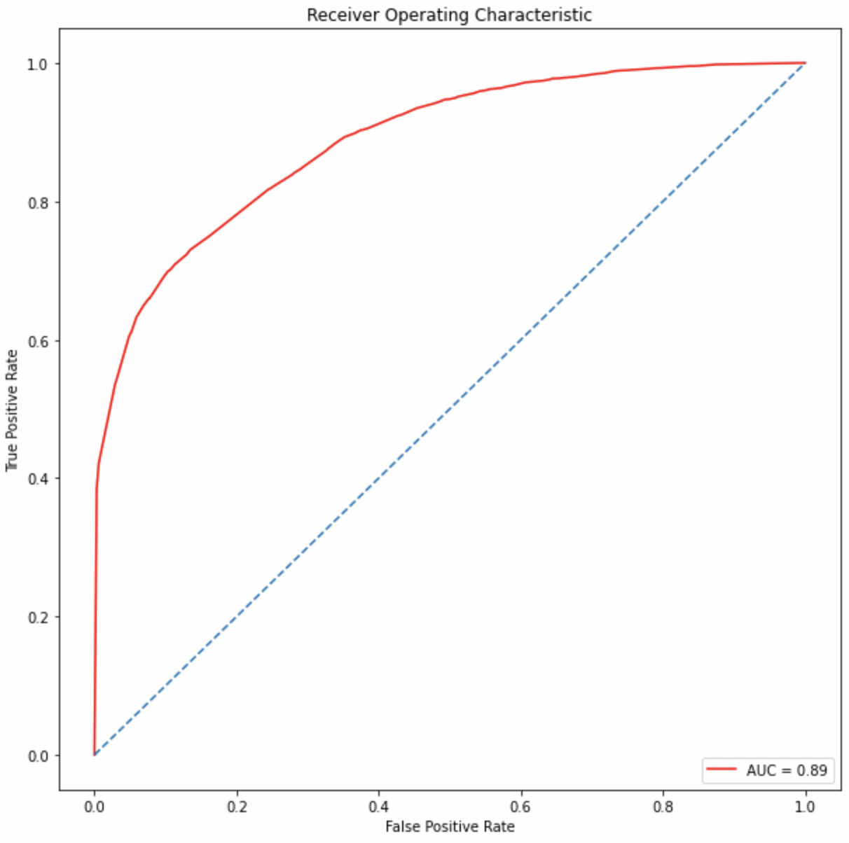
Decision Tree
Decision trees use multiple algorithms to decide to split a node into two or more sub-nodes. The creation of sub-nodes increases the homogeneity of resultant sub-nodes
Decision Tree achieved accuracy score of 82% with the area under ROC curve of 0.89
Test train split = 20%
Notes:
Juhi

Slide 17
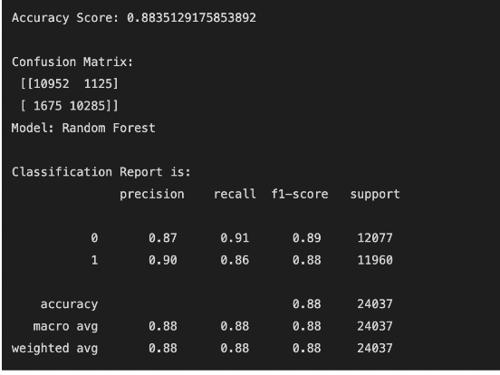
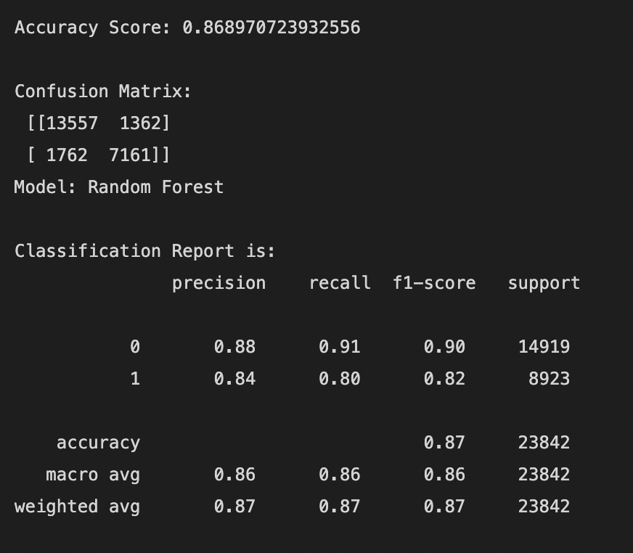
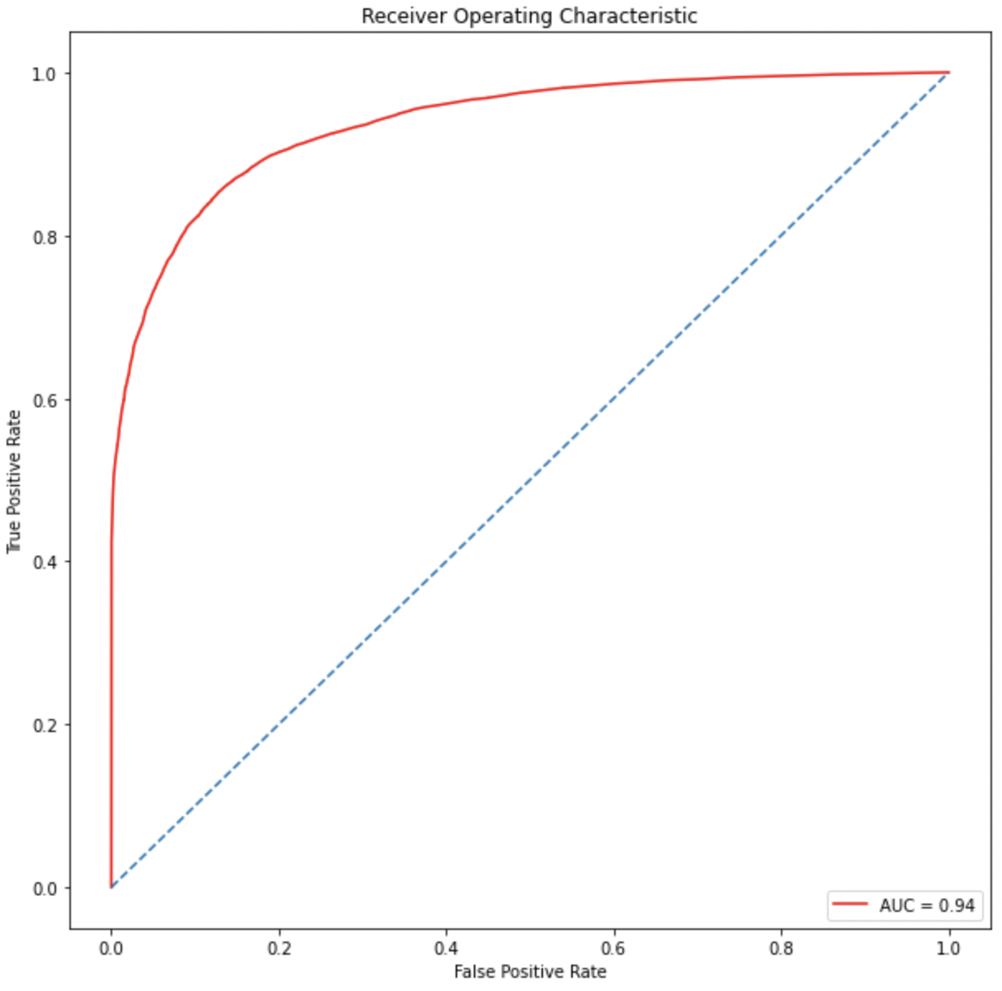
Random Forest
The accuracy score improves after we use a balanced dataset(left table) compared to an unbalanced dataset(right table).
Clearly Random forest outperformed all other models and hence was chosen by us as the final model.
RF achieved accuracy score of 88% with the area under ROC curve of 0.94
Test train split = 20%

Slide 18
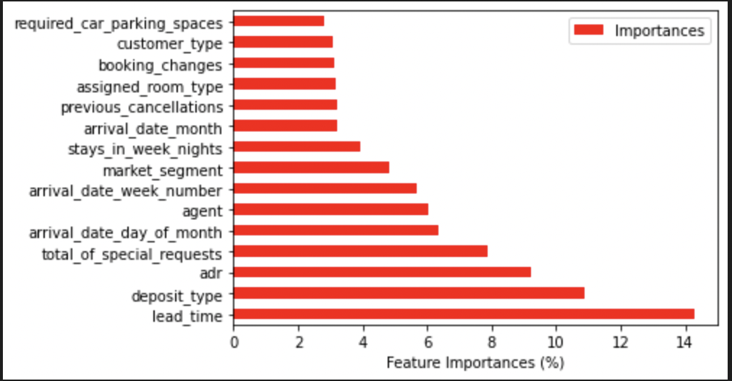
Random Forest Classification
Since, RF model gave the best accuracy score, the feature importance plot of this model was used to decide the most important factors to predict the outcome
The top three predictors were
1. Lead Time
2. Deposit Type
3. Average Daily Rate

Slide 19
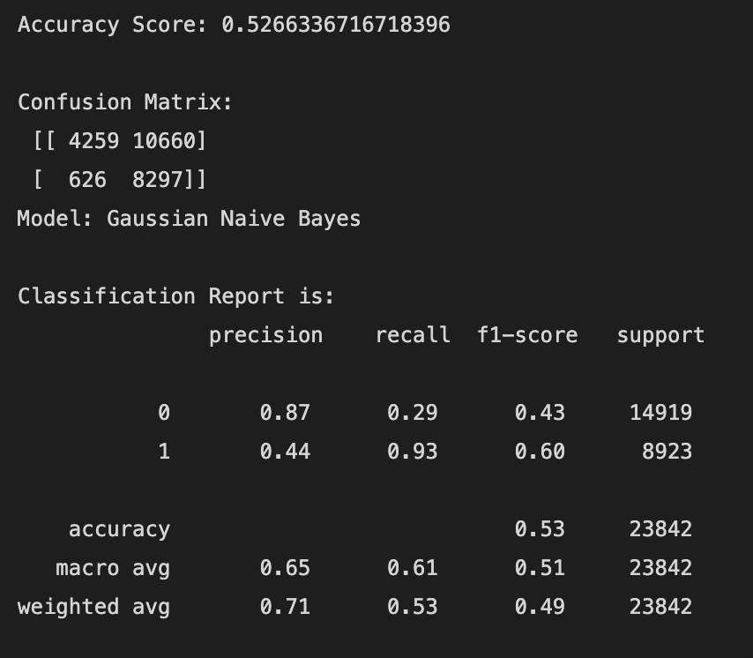
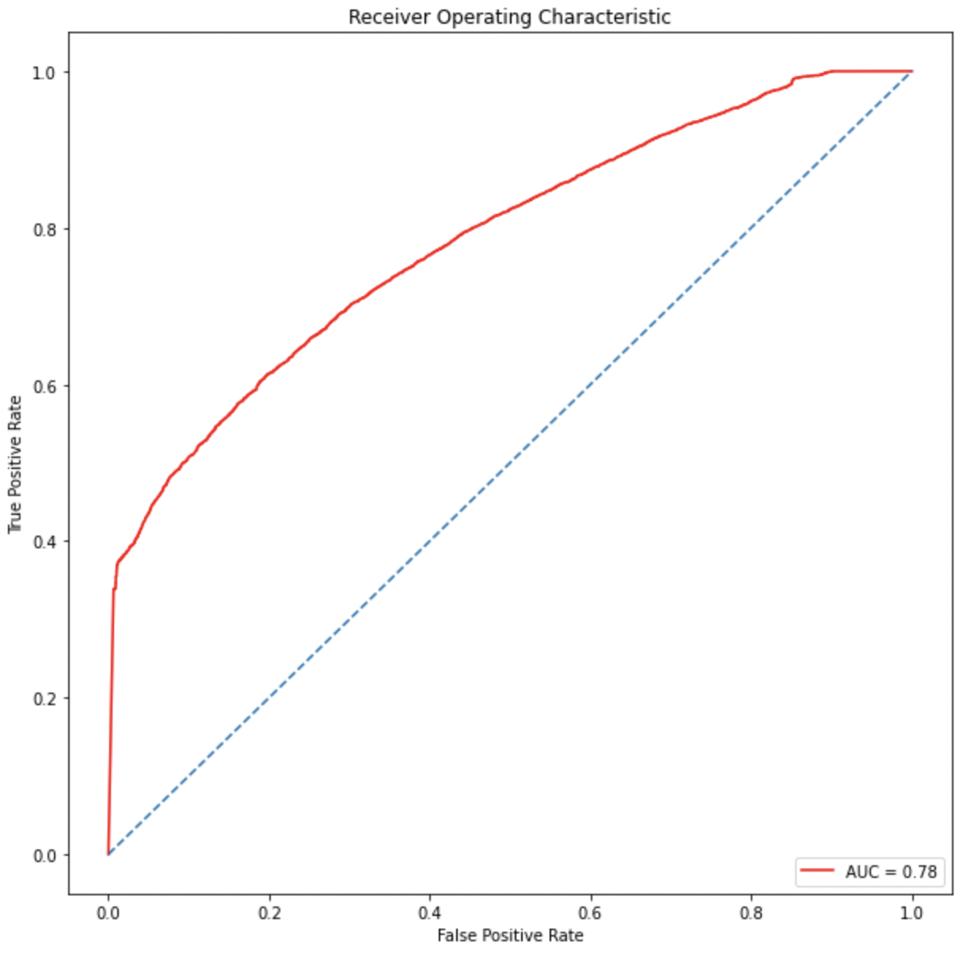
Naïve Bayes
The accuracy score of Naïve Bayes model turned out to be 52.66% with the area under ROC curve of 0.78
The assumption that all features are independent is not applicable in the real world, so it makes the Naïve Bayes algorithm less accurate than more sophisticated models
Test train split = 20%

Slide 20
Conclusion
Model | Accuracy Scores | ROC
Logistic Regression | 0.77 | 0.84
KNN | 0.76 | 0.84
Decision tree | 0.82 | 0.89
Random Forest | 0.88 | 0.94
Naïve Bayes | 0.53 | 0.78
As we can see from the summary table, the best algorithm is the random forest for this data set
Naïve Bayes was the least accurate due to underlying assumptions
The best predictors for cancellation are: Lead time, Deposit type, and Average Daily Rate
The random forest model was chosen as it served the best prediction of hotel booking cancellation.
Notes:
Kshitij

Slide 21
Thank You!

Slide 22
References
https://www.kaggle.com/datasets/jessemostipak/hotel-booking-demand/code
https://www.datacamp.com/tutorial/random-forests-classifier-python
https://medium.com/chinmaygaikwad/build-and-visualize-a-simple-decision-tree-using-
sklearn-and-graphviz-84bda6b6b894

